Slide 1

Knee Arthroscopy System
Presented by: OrthoBiometrix LLC
Tel: 1-407-327-9935
Richard@orthobiometrix.com

Slide 2

Knee Arthroscopy System
Unique in functionality and application
Increases patient safety
Helps standardize operating room procedures
Increases case turnover
Decreases surgical prep time

Slide 3
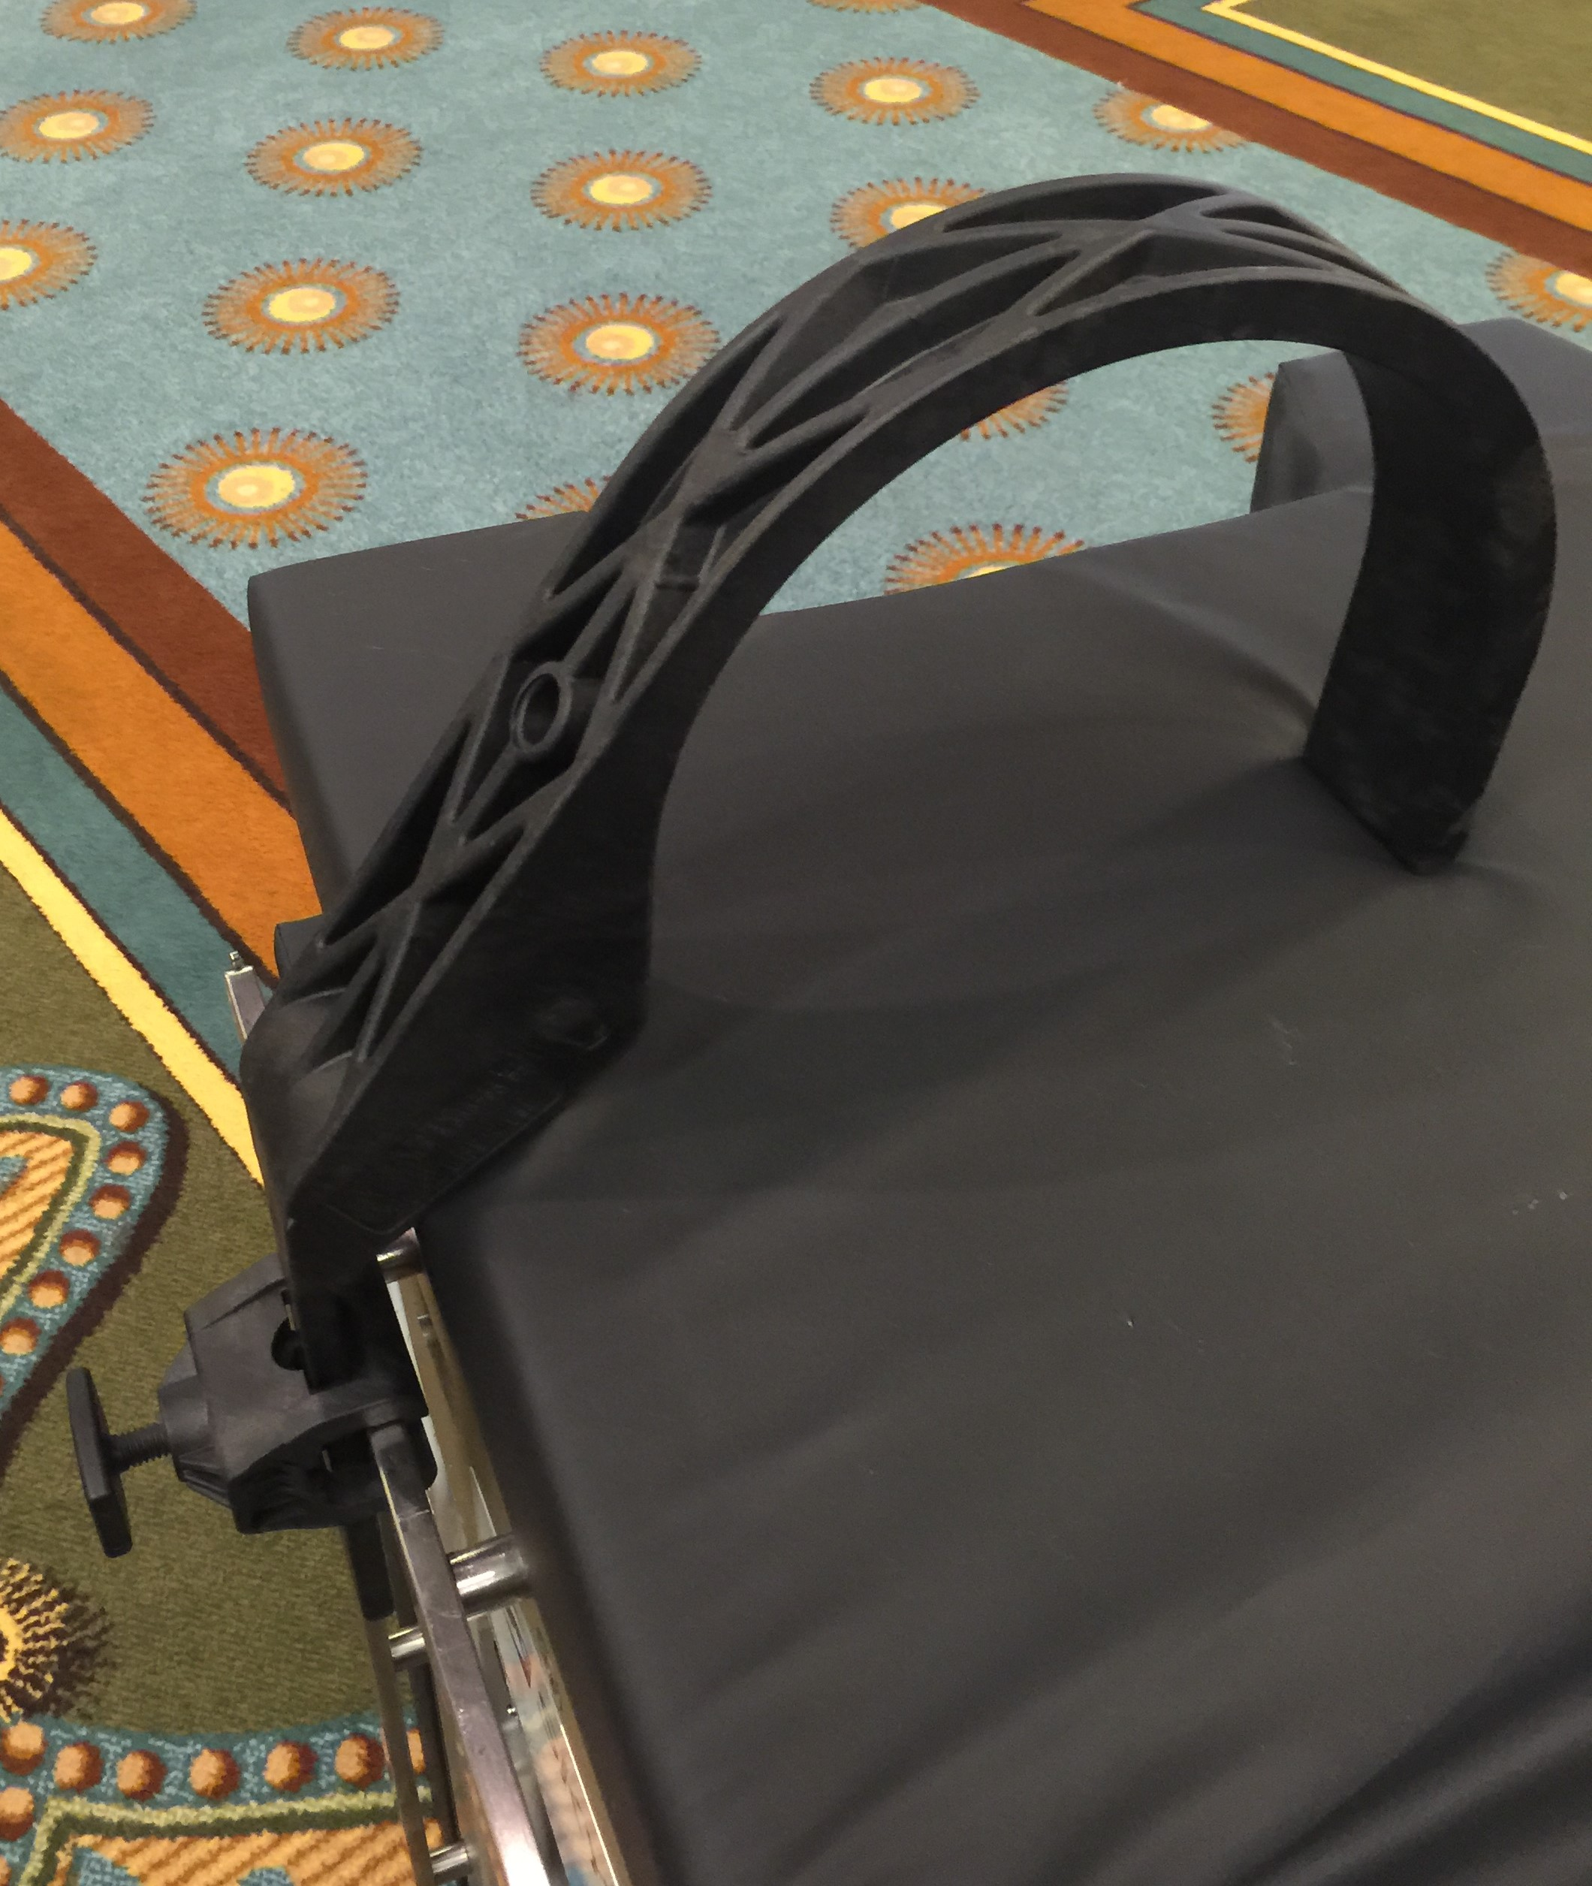
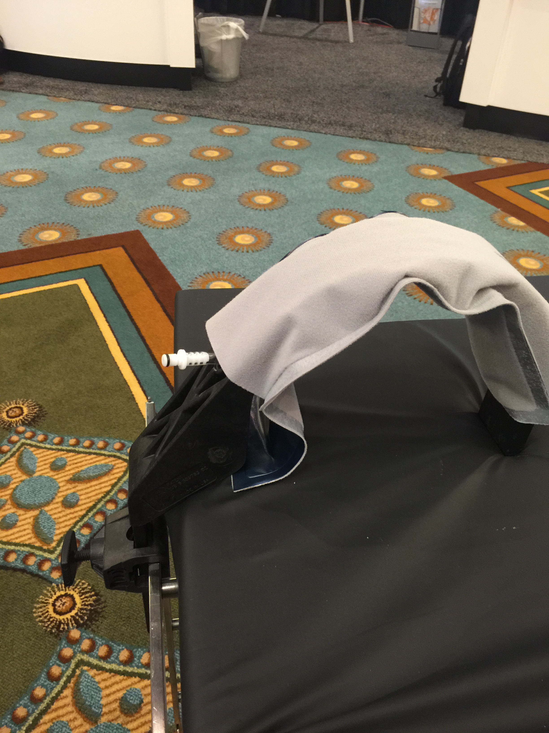
Knee Arthroscopy System Features
Manufactured from polycarbonate materials
Separate detachable compression air bladder
Weighs 1.5 lbs
Separate Patented Universal Clamp manufactured from polycarbonate materials.
Knee Restraint System

Slide 4
Knee Arthroscopy System
Medical Advantages
Easy set-up and removal
Total access to knee joint
Allows for full manipulation and
stressing of knee joint
Supports distal thigh
Facilitates sterile draping
Knee Restraint System

Slide 5
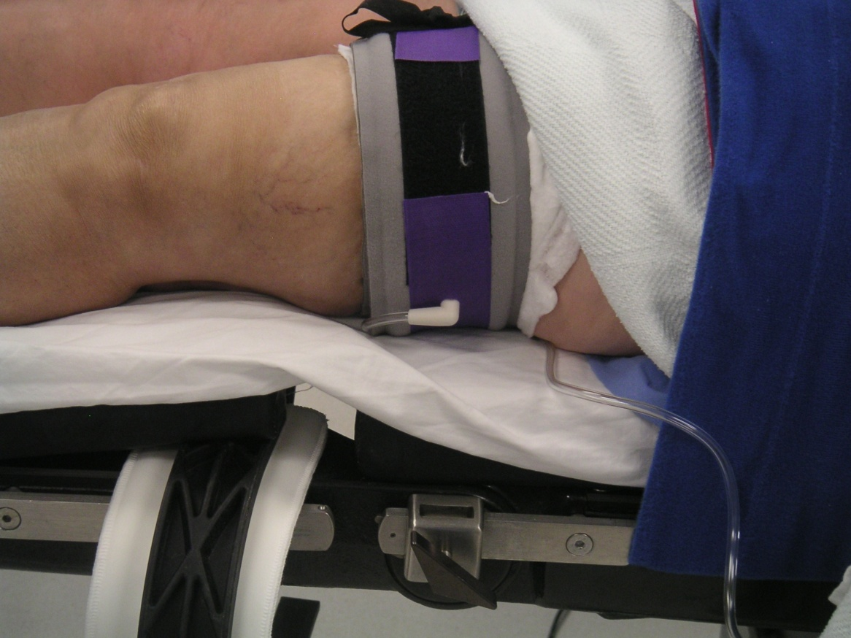
Knee Arthroscopy System
OR Procedures
1. Apply tourniquet and inflate to required pressure.
Knee Restraint System

Slide 6
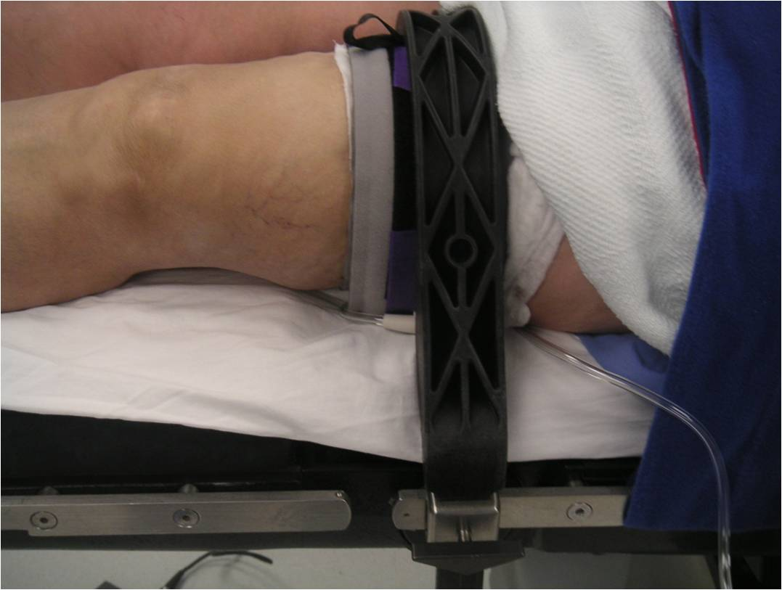
Knee Arthroscopy System
OR Procedures
2. Insert knee restraint into universal clamp
Knee Restraint System

Slide 7
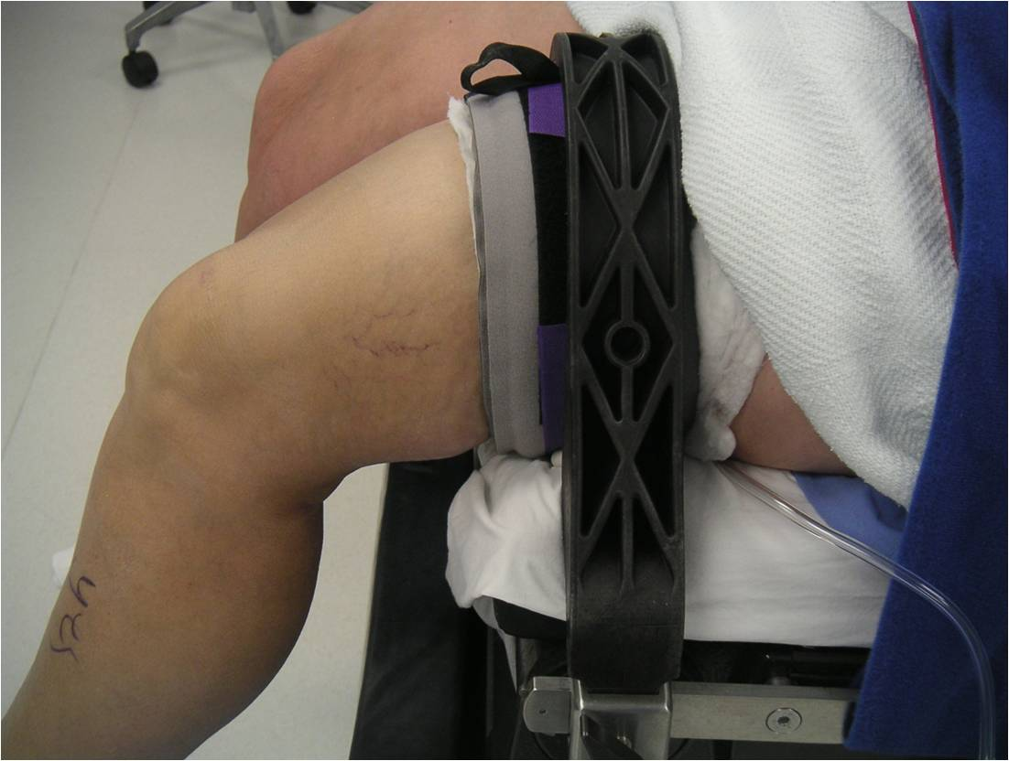
Knee Arthroscopy System
OR Procedures
3. Check for correct brace position to table break.
Knee Restraint System

Slide 8
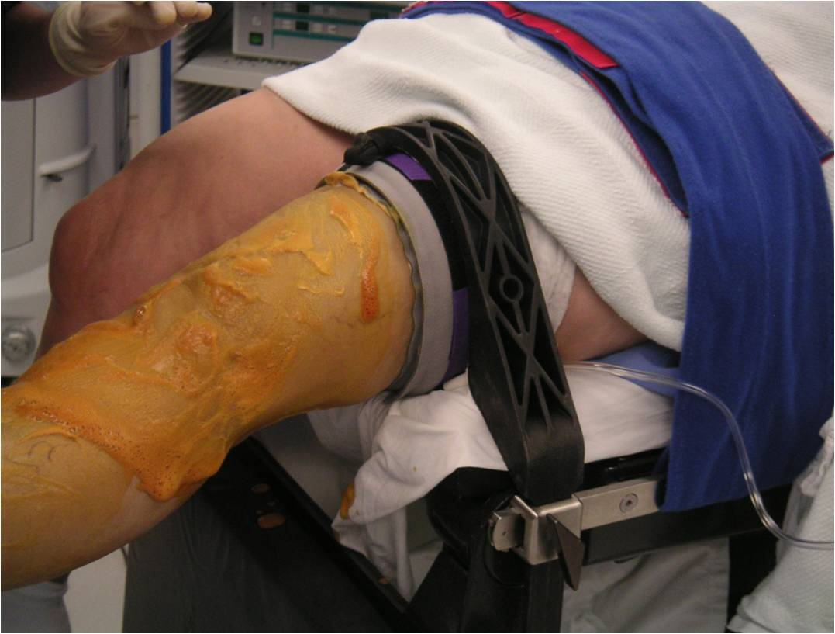
Knee Arthroscopy System
OR Procedures
4. Continue with standard prepping and draping.
Knee Restraint System

Slide 9
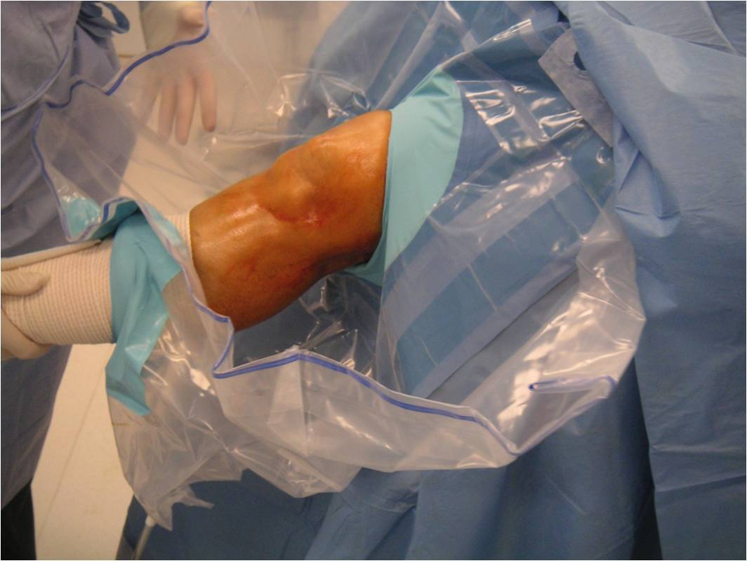
Knee Arthroscopy System
OR Procedures
5. Prepping and draping continued.
Knee Restraint System

Slide 10
Knee Arthroscopy System
A Clinical Study | Dr. Brett Casey
43 successful knee arthroscopic cases and 10 ACL cases.
Diagnoses:
  Medial meniscus tears, lateral meniscus tears, ACL tears, OCD, and arthrofibrosis of the knee.
Knee Restraint System

Slide 11
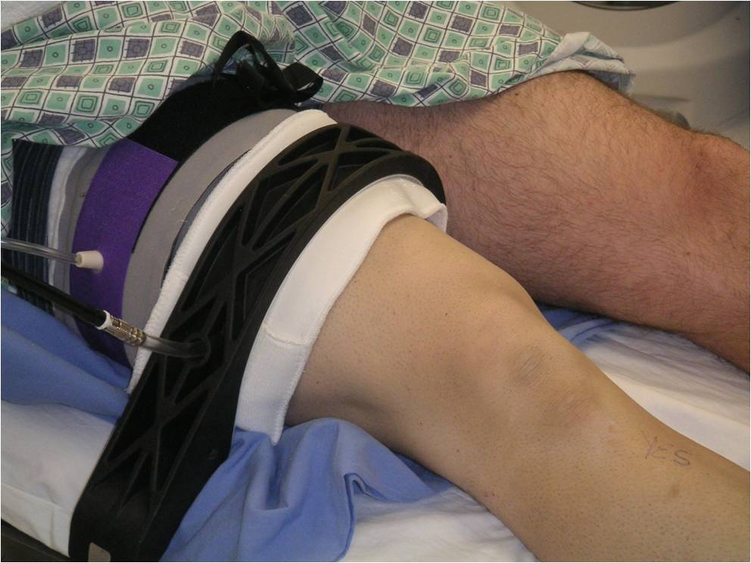
Knee Arthroscopy System
Case Study | Meniscus/ACL Repair
System used to
stabilize the leg.
Knee Restraint System

Slide 12
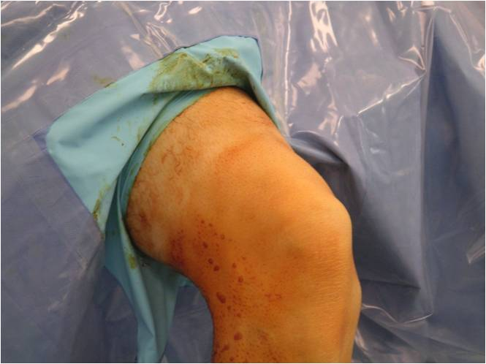
Knee Arthroscopy System
Case Study | Meniscus/ACL Repair
Set-up, prep, and drape.
Knee Restraint System

Slide 13
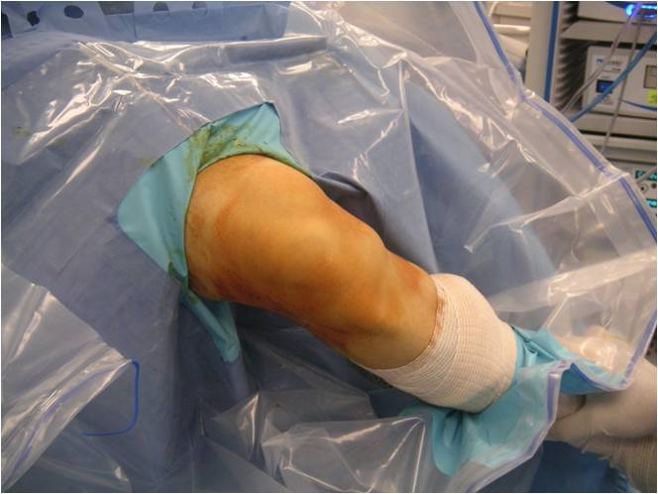
Knee Arthroscopy System
Case Study | Meniscus/ACL Repair
Surgeon has total control over the amount of varus or valgus stress applied to the patient’s knee.
Knee Restraint System

Slide 14
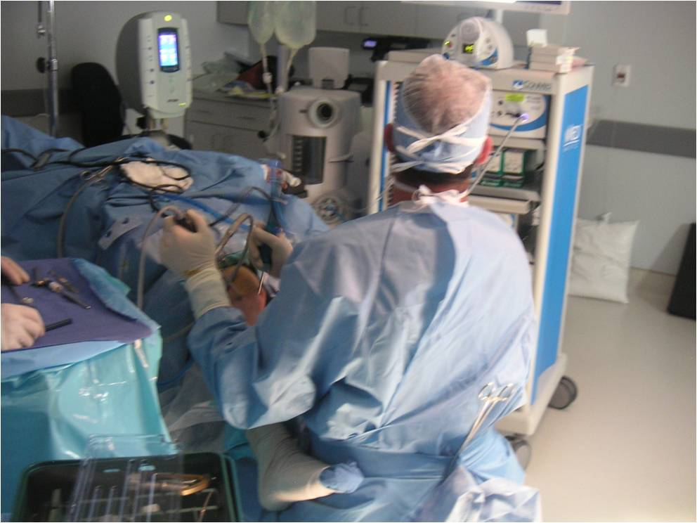
Knee Arthroscopy System
Case Study | Meniscus/ACL Repair
Design allows surgeon to sit or stand, safely applying maximum pressure to leg.
Knee Restraint System

Slide 15
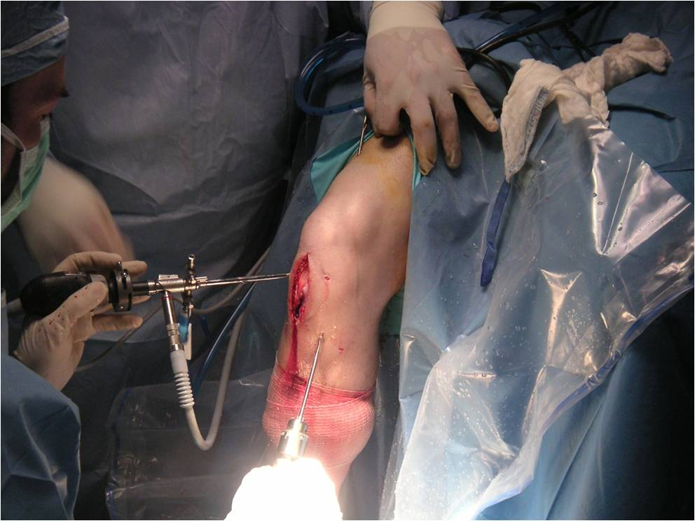
Knee Arthroscopy System
Case Study | Meniscus/ACL Repair
System remains on during ACL repair.
Knee Restraint System

Slide 16
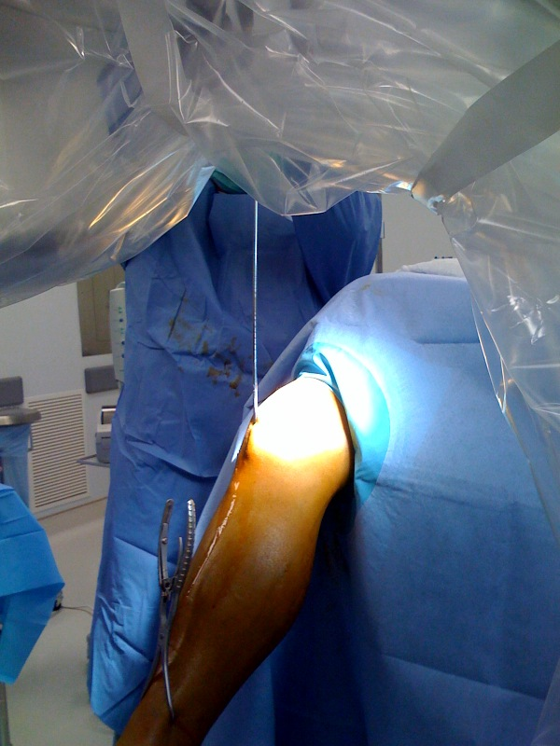
Knee Arthroscopy System
Case Study | Fractured Tibia
System used to stabilize the leg
during tibial shaft fracture repair.
Knee Restraint System

Slide 17
Knee Arthroscopy System
OR Procedures
6. System allows for greatest exposure of knee joint.
Knee Restraint System

Slide 18
Knee Arthroscopy System
Synovectomy of Knee Diagnosis
A 31 year old male with arthrofibrosis following arthroscopic ACL reconstruction and medial meniscus repair.
ACL and MMT injury with restricted knee ROM.
Patient scheduled for arthroscopic lysis of adhesions and manipulation.
Knee Restraint System

Slide 19
Knee Arthroscopy System
Synovectomy of Knee
Case Set-up
Patient placed on OR table in supine position and anesthetized.
Patient repositioned with the patella distal to the knee break of the OR table, allowing the lower extremity to be perpendicular to the floor.
Using standard procedure, a tourniquet was applied to the upper thigh and inflated.
The brace is placed over the leg, vertical stem down into the OR table bracket.
The brace bladder was inflated to 150 mm hg of pressure.
Knee Restraint System

Slide 20
Knee Arthroscopy System
Synovectomy of Knee
Procedure
Standard arthroscopic portals established, diagnostic arthroscopy performed.
Patient noted to have extreme notch fibrosis, intact ACL repair, and healed meniscus.
Synovectomy performed and dressing applied.
Knee Restraint System

Slide 21
Knee Arthroscopy System
Synovectomy of Knee
Results
Case completed successfully.
Full ROM achieved.
Patient resumed participation in competitive recreational soccer and softball sport clubs.
Knee Restraint System

